Slide 1




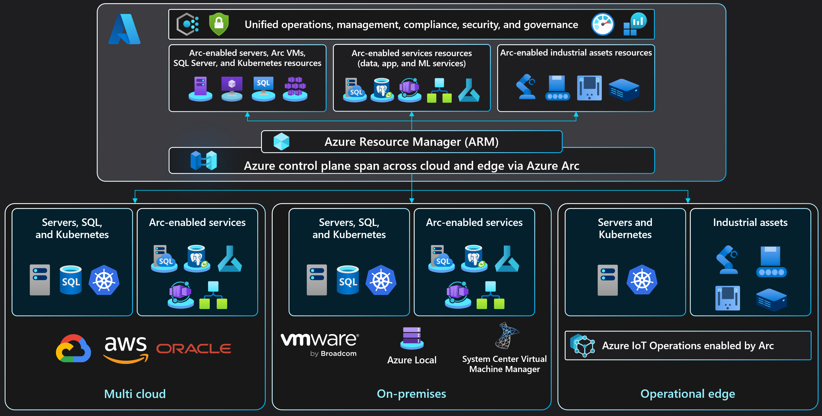
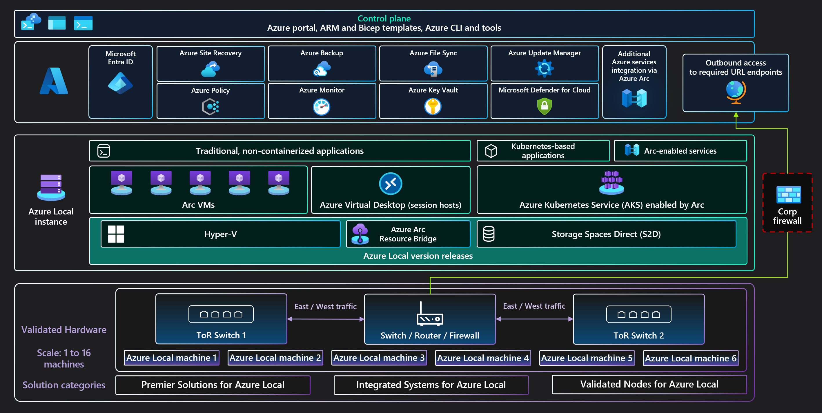
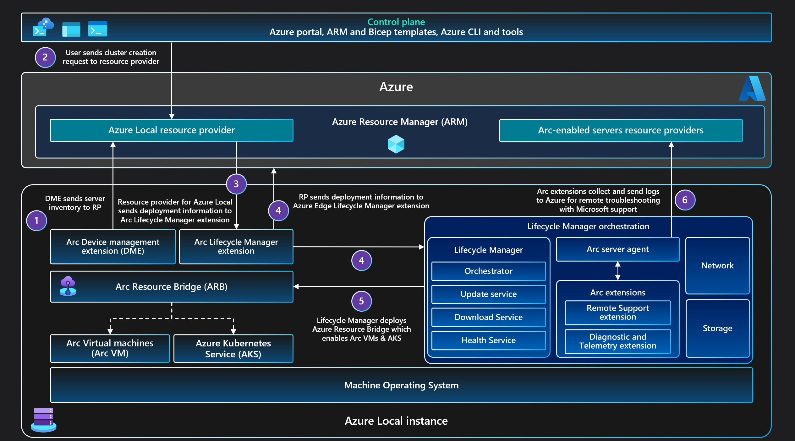
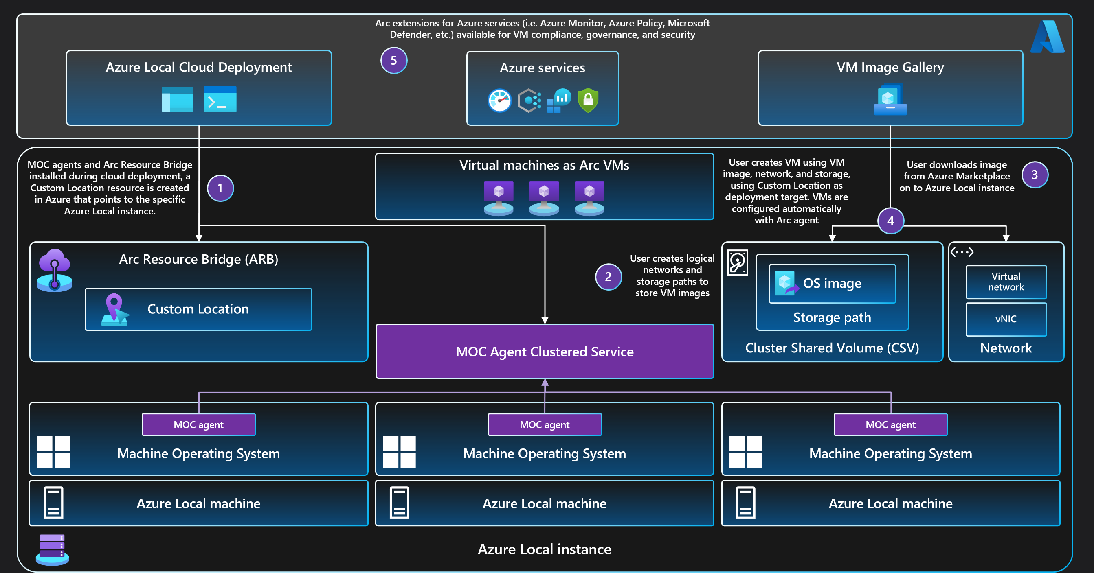
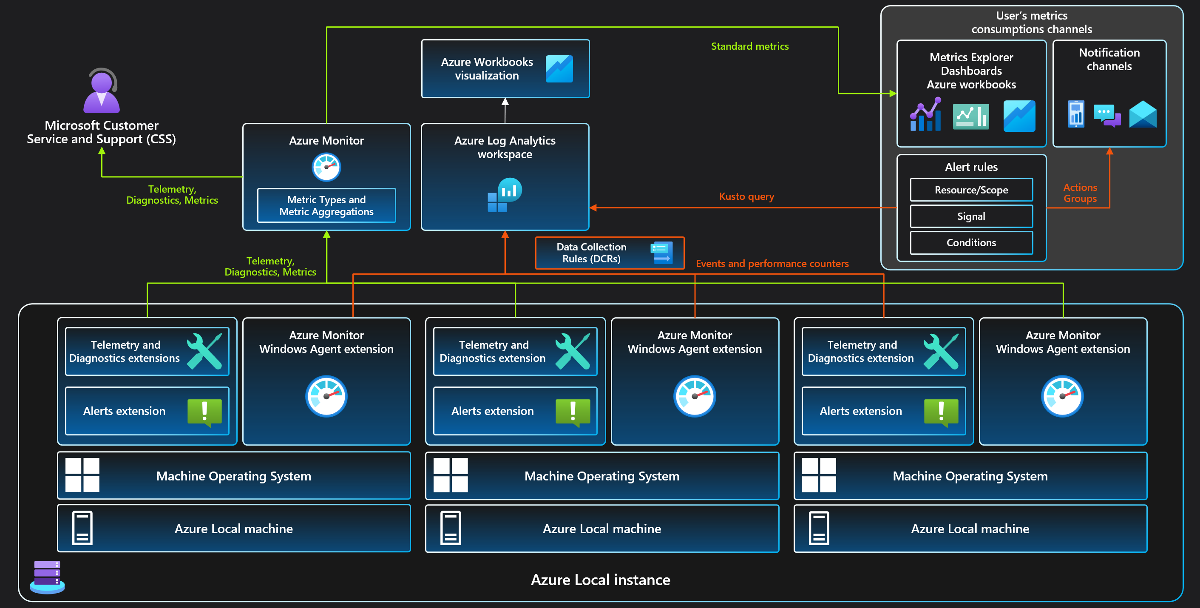
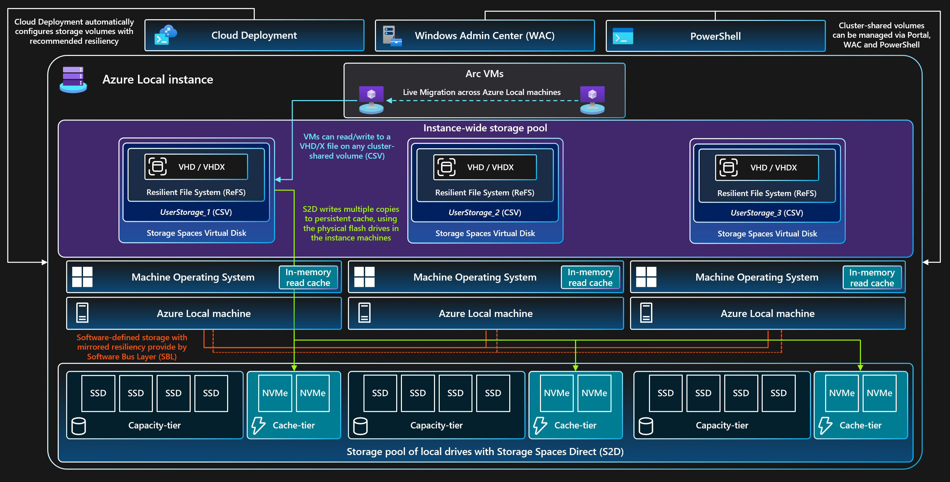
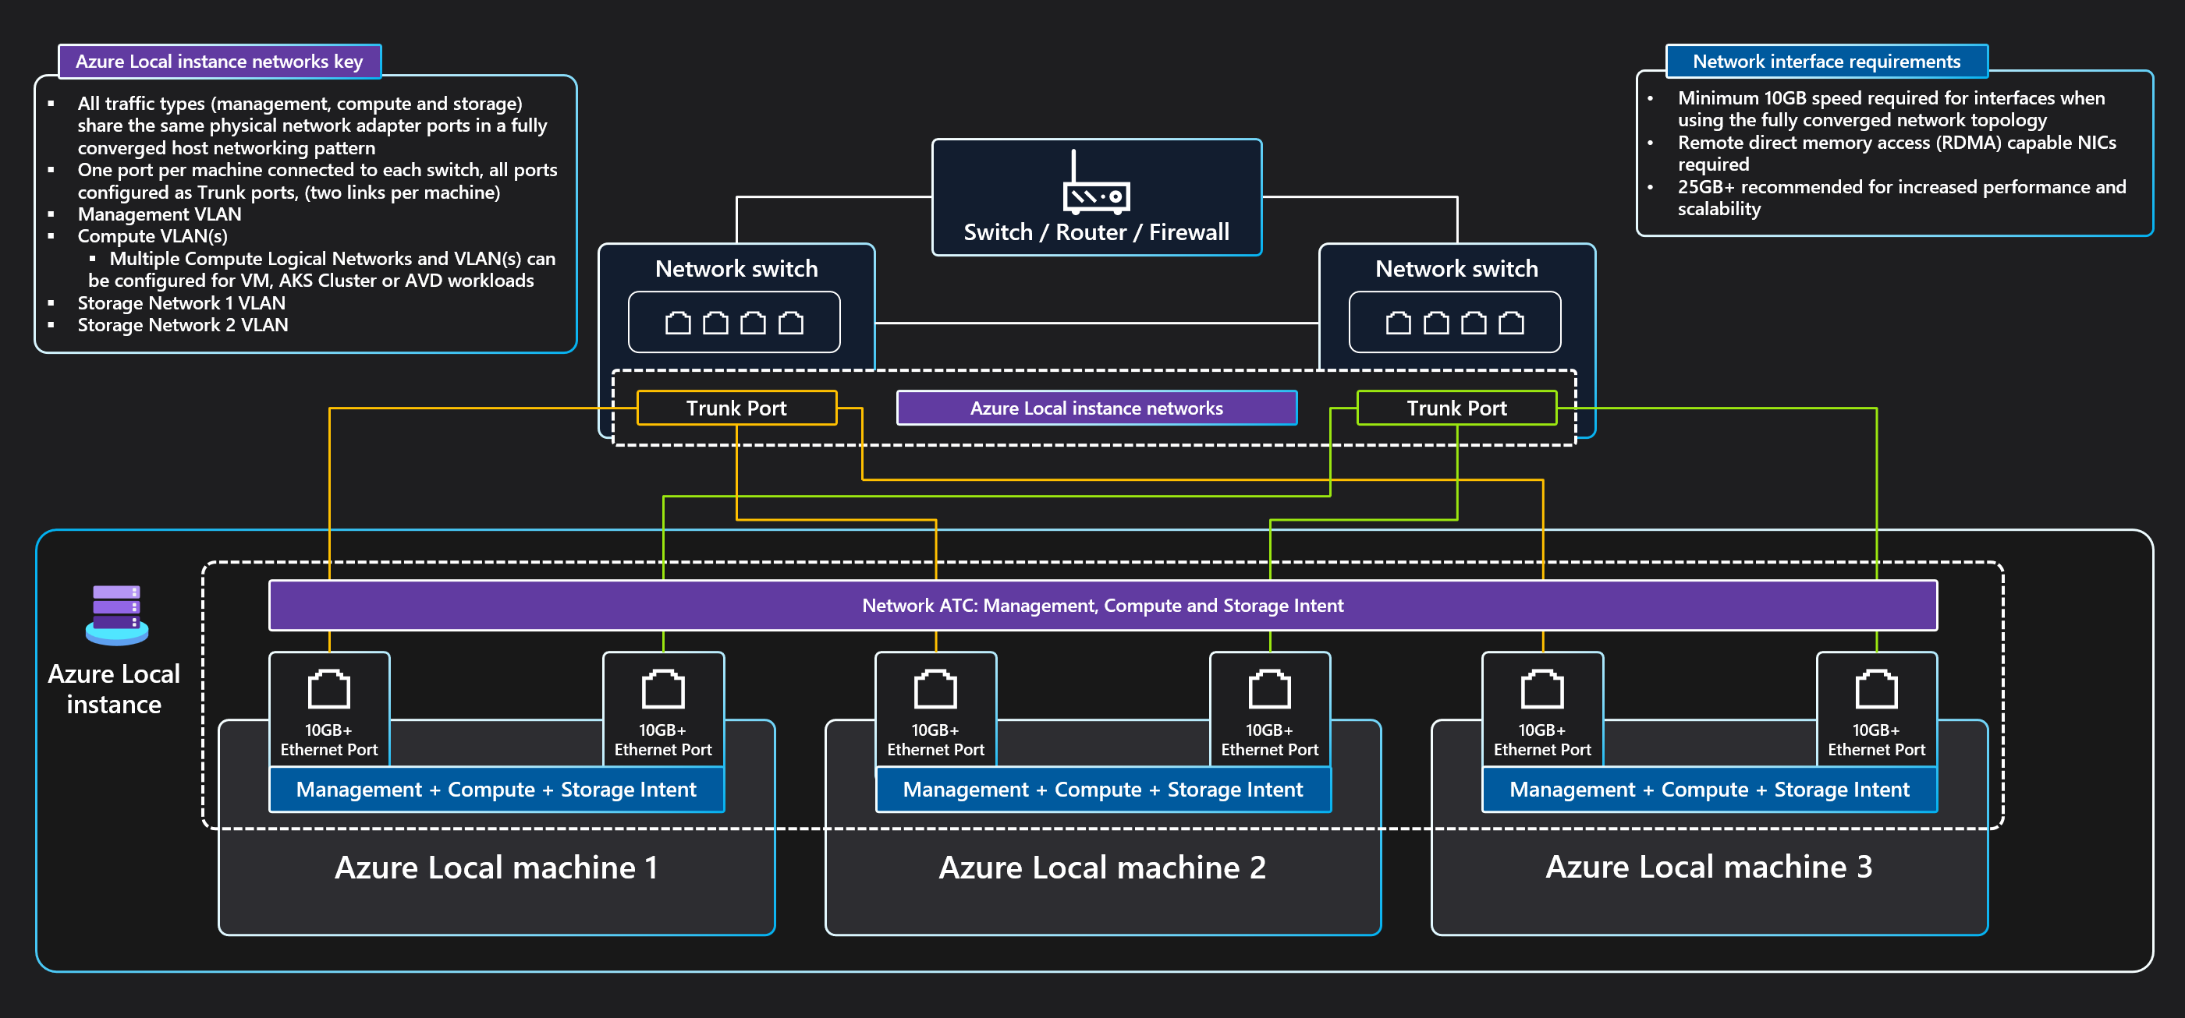
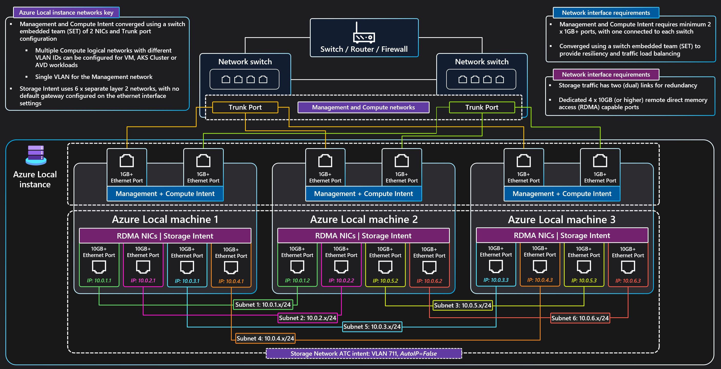
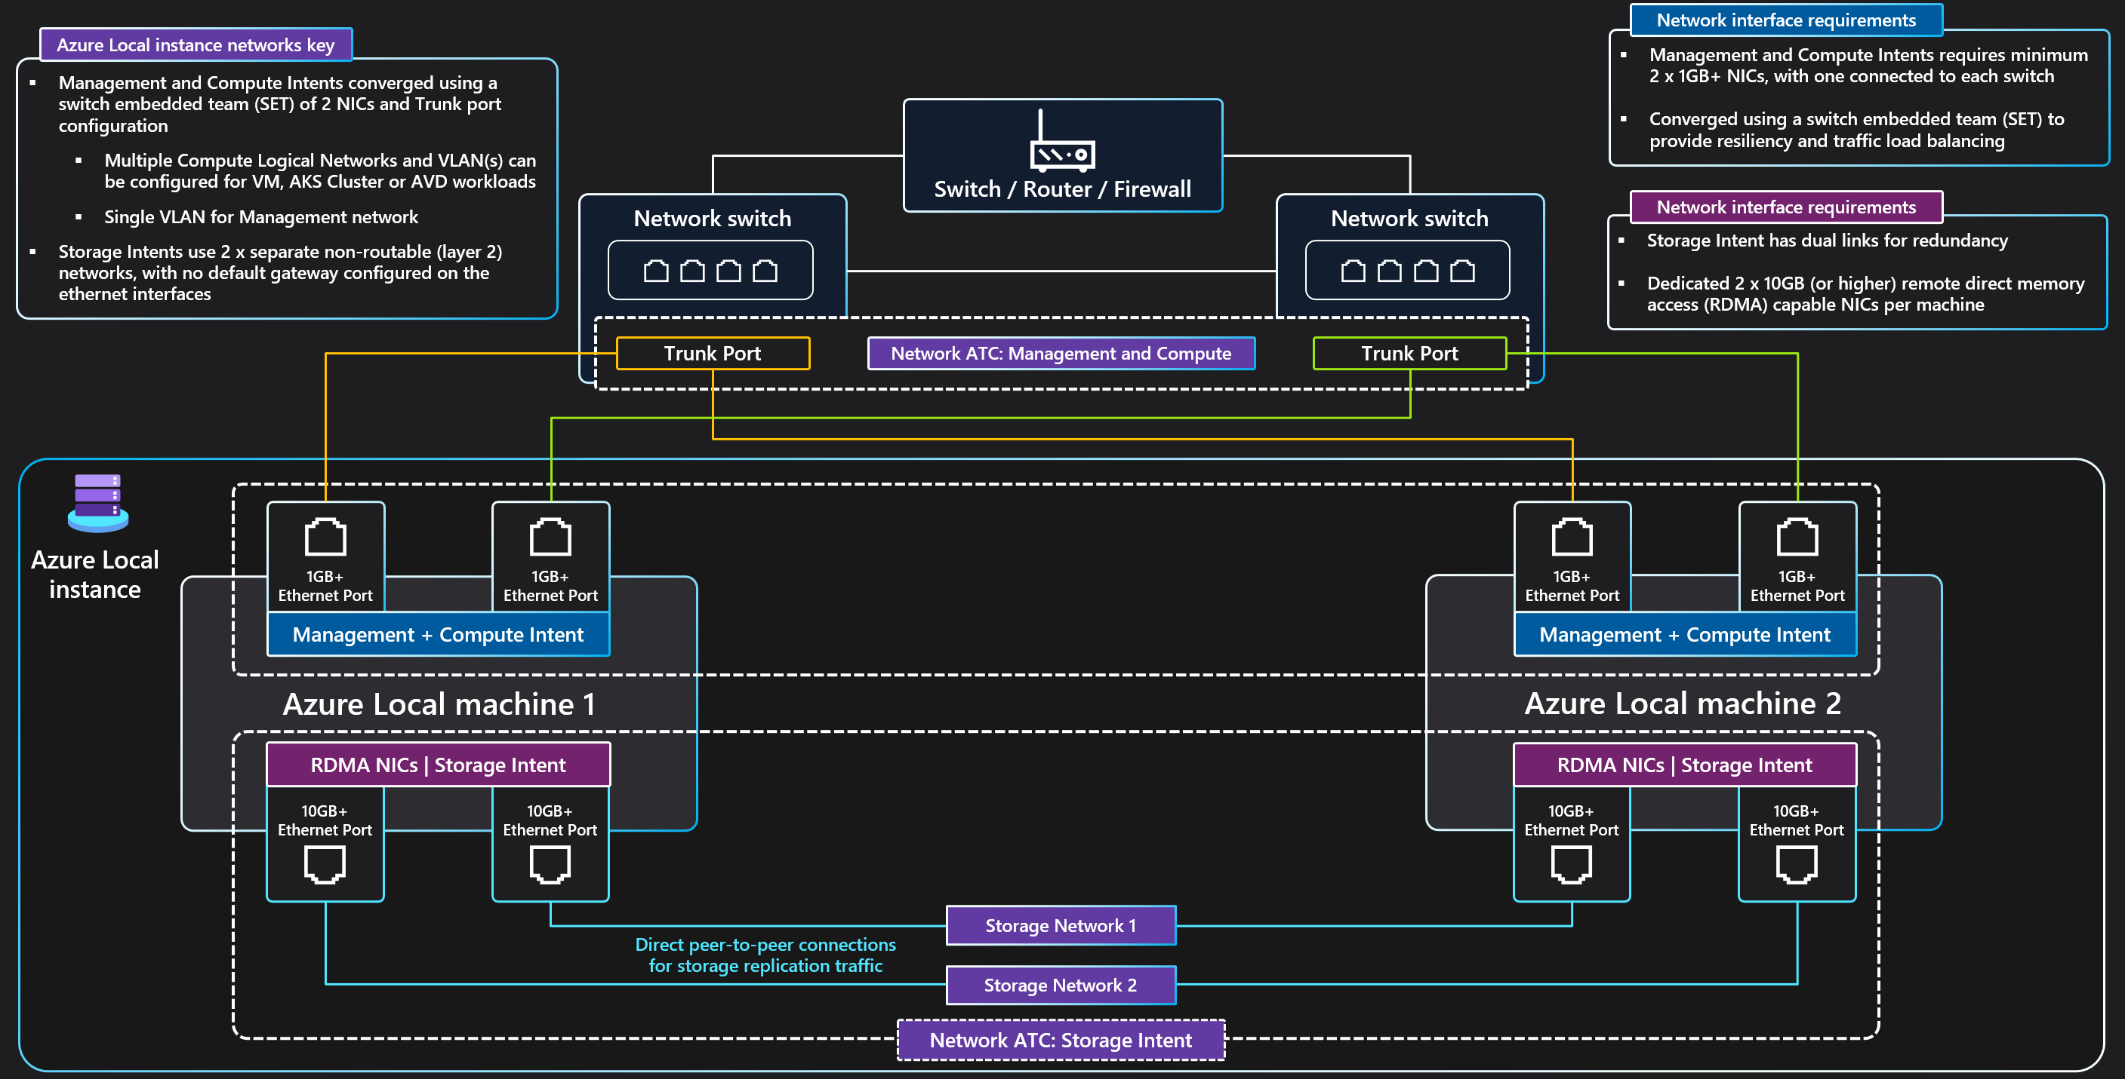

Azure Local
Azure Arc solution architecture
Solution reference architecture
Cloud-based deployment architecture
Arc virtual machine architecture
Monitoring flow architecture
Storage architecture
Fully converged network architecture
Three-machines switchless dual link, dual TOR network architecture
Two-machines switchless dual link network architecture
Copyright @ 2025 Microsoft. All rights reserved. v1.1 #ArcJumpstart | aka.ms/JumpstartGems

